Slide 1
What type of learner are you?

Slide 2
Memorize the following sequence of 14 letters:
IB MJ FKFB IUS ACD
Now try again with this
arrangement of letters:
IBM JFK FBI USA CD

Slide 3
Just as grouping the letters differently so they make sense makes it easier to memorize, knowing how your brain works and changing strategies to meet your needs makes it easier to learn.

Slide 4
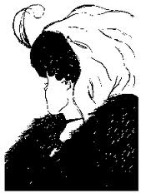
What do you see?
An old lady or a young lady? Both?
The old woman's mouth is the young woman's necklace. The old woman's nose is the young woman's chin. They share their hair, the scarf, the fur coat and the feather in their hair.

Slide 5
Some of the ways people think differently is…

Slide 6
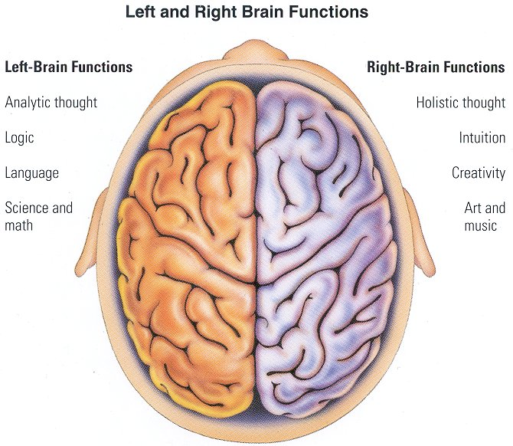
Using either their left or right brains more than the other (called dominance)

Slide 7
Left vs. Right Brain
___Analyzes problems | ___Uses intuition to solve problems
___Tries harder under stress | ___Feels overwhelmed under stress
___Looks at differences | ___Looks at similarities
___Likes structure | ___Likes Spontaneity
___Controls feelings | ___Free with feelings
___Good at remembering names | ___Good at remembering faces
___Likes to do things one at a time | ___Likes to do several things at once
___Likes multiple choice questions | ___Likes essay questions
___Time conscious (always on time) | ___Own concept of time (often late)
___Likes neatness/organization | ___High tolerance for clutter, messy
___Careful, don’t take risks | ___Risk-taker
___Likes clothes folded and lined up | ___Uses a jam it and cram it system

Slide 8
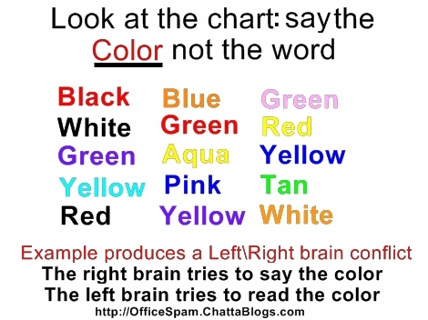

Slide 9
Learning better through:
seeing (visual)
hearing (auditory)
doing (kinesthetic)

Slide 10
How many letter “F"s are there in the following sentence?
Finished files are the result of years of scientific study combined with the experience
of many years.

Slide 11
Everyone has up to eight different intelligences in which some are used more often than others (dominance)

Slide 12
Multiple Intelligences
Intelligence
Definition
Verbal/Linguistic
Logical/Mathematical
Musical/Rhythmic
Naturalist
Visual/Spatial
Intrapersonal
Interpersonal
Bodily/Kinesthetic
word smart
logic smart
music smart
classifying smart
art smart
self smart
people smart
body smart

Slide 13
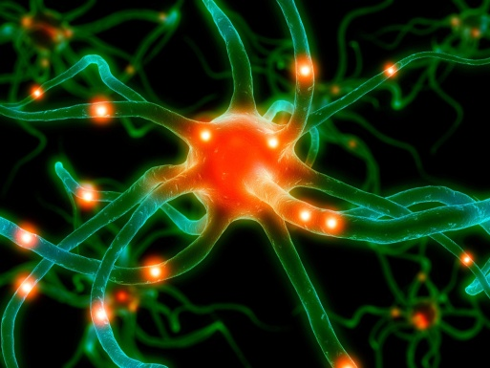
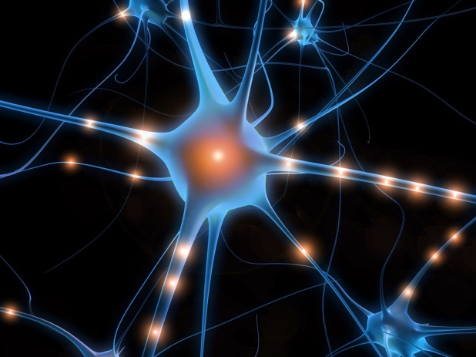
There are many kinds of SMART!

